Slide 1
COMP 2230
Week 2 - Friday

Slide 2
Last time
Predicate logic
  Universal quantifier
  Existential quantifier
  Negating quantifiers
  Multiple quantifiers

Slide 3
Questions?

Slide 4
Assignment 1

Slide 5
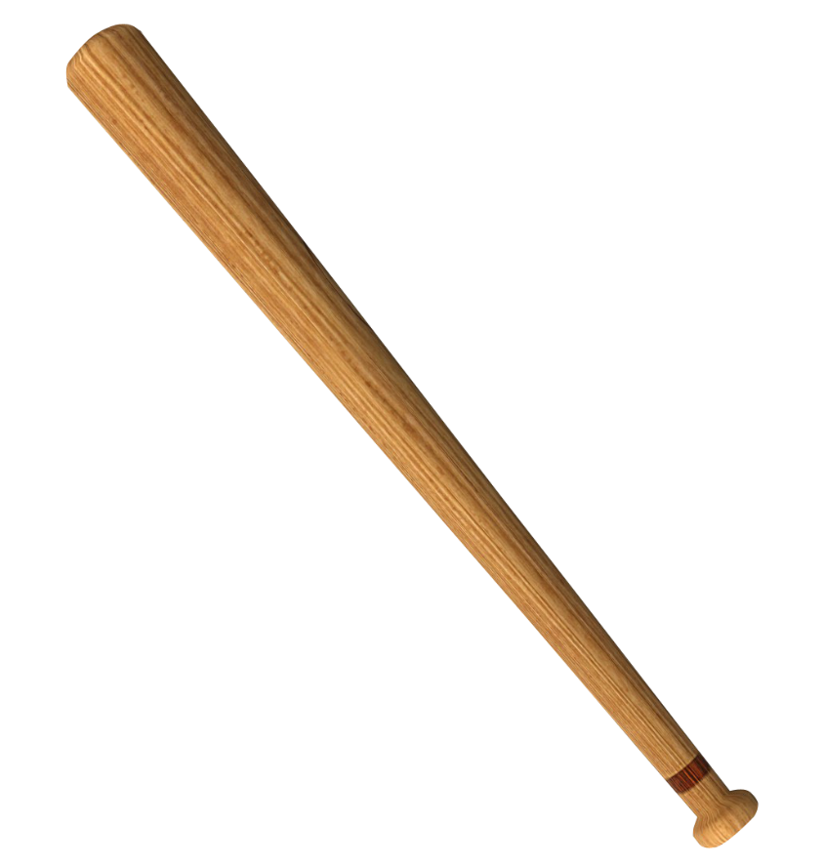
Logical warmup
A bat costs $1 more than a ball
Together, they cost $1.10
How much does the ball cost?
This Photo by Unknown Author is licensed under CC BY-NC

Slide 6
Multiple Quantifiers

Slide 7
Practice
Given the formal statements with multiple quantifiers for each of the following:
  There is someone for everyone.
  All roads lead to some city.
  Someone in this class is smarter than everyone else.
  There is no largest prime number.

Slide 8
Negating multiply quantified statements
The rules don't change
Simply switch every ∀ to ∃ and every ∃ to ∀
Then negate the predicate
Write the following formally:
  "Every rose has a thorn"
Now, negate the formal version
Convert the formal version back to informal

Slide 9
Changing quantifier order
As show before, changing the order of quantifiers can change the truth of the whole statement
However, it does not necessarily
Furthermore, quantifiers of the same type are commutative:
  You can reorder a sequence of ∀ quantifiers however you want
  The same goes for ∃
  Once they start overlapping, however, you can't be sure anymore

Slide 10
Arguments with Quantified Statements

Slide 11
Quantification in arguments
Quantification adds new features to an argument
The most fundamental is universal instantiation
  If a property is true for everything in a domain (universal quantifier), it is true for any specific thing in the domain
Example:
  All the party people in the place to be are throwing their hands in the air!
  Julio is a party person in the place to be
  ∴Julio is throwing his hands in the air

Slide 12
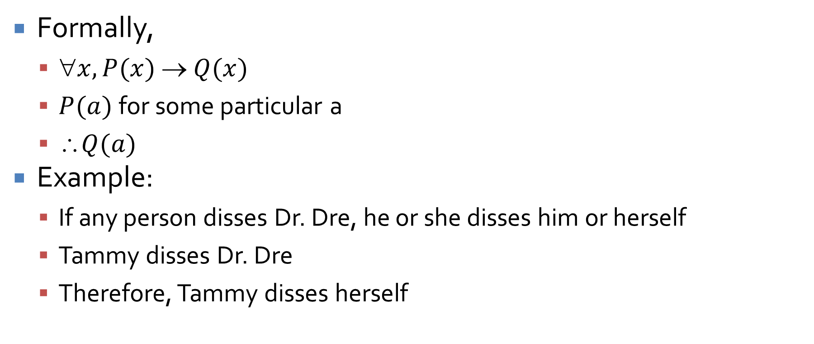
Universal modus ponens
Formally,
  $x, P(x)  Q(x)$
  $P(a)$for some particular a
  ∴$Q(a)$
Example:
  If any person disses Dr. Dre, he or she disses him or herself
  Tammy disses Dr. Dre
  Therefore, Tammy disses herself

Slide 13
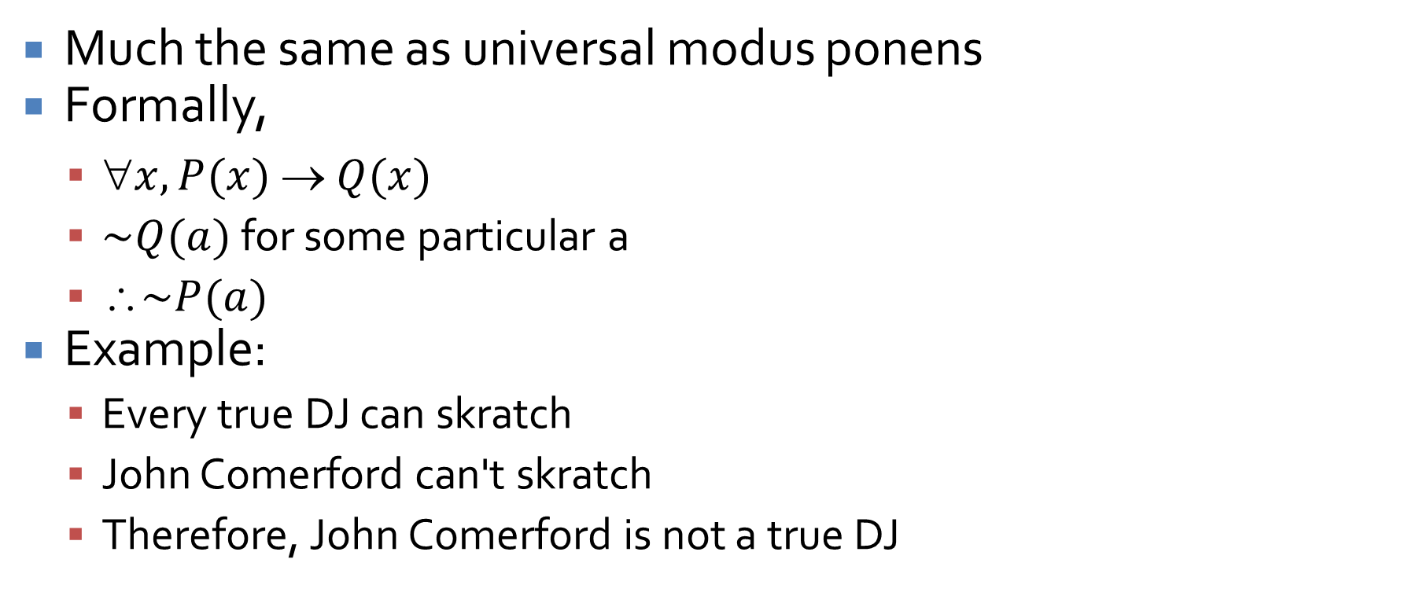
Universal modus tollens
Much the same as universal modus ponens
Formally,
  $x, P(x)  Q(x)$
  $\sim Q(a)$ for some particular a
  ∴$\sim P(a)$
Example:
  Every true DJ can skratch
  John Comerford can't skratch
  Therefore, John Comerford is not a true DJ

Slide 14
Inverse and converse errors strike again
Unsurprisingly, the inverse and the converse of universal conditional statements do not have the same truth value as the original
Thus, the following are not valid arguments:
  If a person is a superhero, he or she can fly.
  Astronaut John Blaha can fly.
  Therefore, John Blaha is a superhero. FALLACY
  A good man is hard to find.
  Osama Bin Laden is not a good man.
  Therefore, Osama Bin Laden is not hard to find. FALLACY

Slide 15
Venn diagrams
We can test arguments using Venn diagrams
To do so, we draw diagrams for each premise and then try to combine the diagrams
Touchable things
This

Slide 16

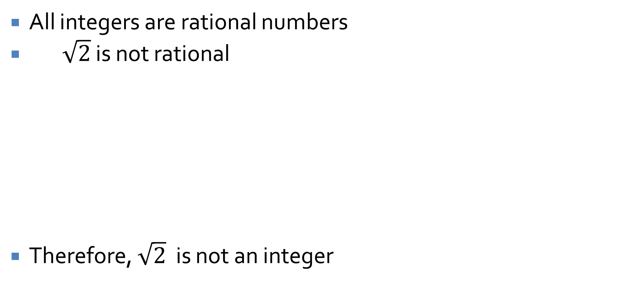

Diagrams showing validity
rational numbers
All integers are rational numbers
$\sqrt{2}$ is not rational
Therefore, $\sqrt{2}$ is not an integer
integers
rational numbers
$$\sqrt{2}$$
rational numbers
$$\sqrt{2}$$
integers

Slide 17
Diagrams showing invalidity
cats
All tigers are cats
Panthro is a cat
Therefore, Panthro is a tiger
tigers
cats
cats
Panthro
cats
tigers
tigers
Panthro
Panthro

Slide 18
Be careful
Diagrams can be useful tools
However, they don't offer the guarantees that pure logic does
Note that the previous slide makes the converse error unless you are very careful with your diagrams

Slide 19
Two kinds of equal signs
In Java (and many other languages), there are two kinds of equal signs: = (assignment) and == (testing for equality)
Mathematicians have two as well, but they use the same symbol!
One kind of equal sign is a definition
The other kind is a theorem

Slide 20
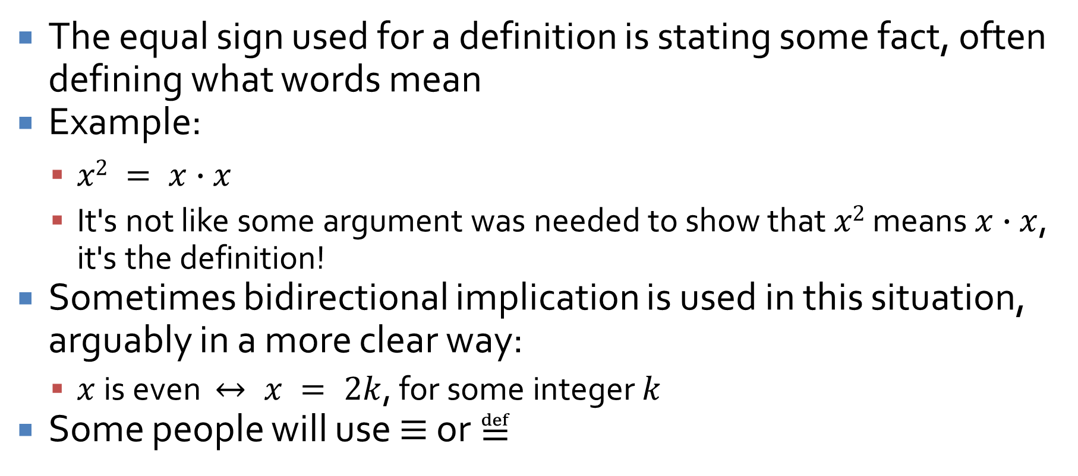
Definition equals
The equal sign used for a definition is stating some fact, often defining what words mean
Example:
  $x2 = x∙x$
  It's not like some argument was needed to show that $x2$ means $x∙x$, it's the definition!
Sometimes bidirectional implication is used in this situation, arguably in a more clear way:
  $x$ is even $↔ x = 2k$, for some integer $k$
Some people will use $≡$ or $≝$

Slide 21
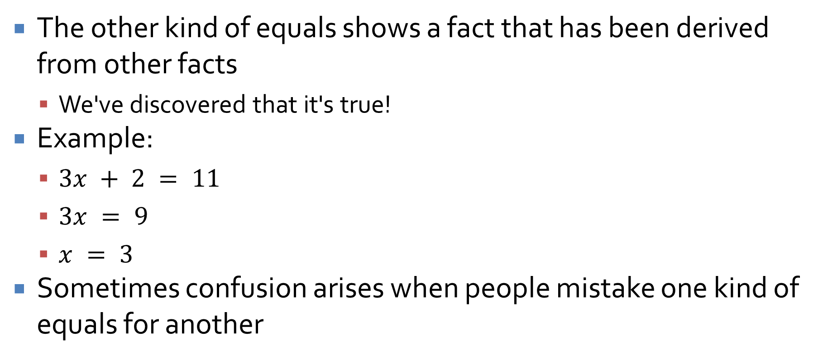
Theorem equals
The other kind of equals shows a fact that has been derived from other facts
  We've discovered that it's true!
Example:
  $3x + 2 = 11$
  $3x = 9$
  $x = 3$
Sometimes confusion arises when people mistake one kind of equals for another
Definition
Theorem
Theorem

Slide 22
Proving Existential Statements and Disproving Universal Ones

Slide 23
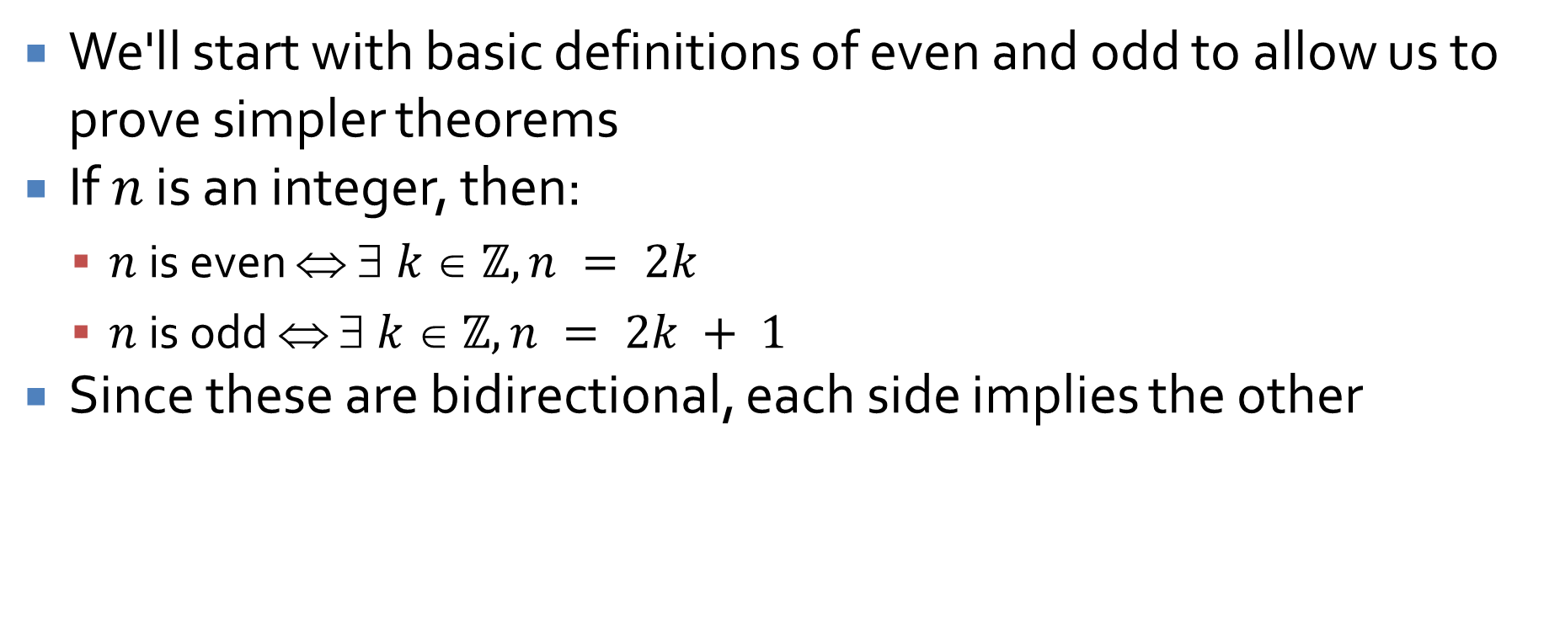
A useful definition
We'll start with basic definitions of even and odd to allow us to prove simpler theorems
If $n$ is an integer, then:
  $n$ is even ⇔ $ k  ℤ, n = 2k$
  $n$ is odd ⇔ $ k  ℤ, n = 2k + 1$
Since these are bidirectional, each side implies the other

Slide 24

Another useful definition
If $n$ is an integer where $n > 1$, then:
  $n$ is prime ⇔ $ r ℤ+,  s ℤ+,$ if $n = rs$, then $r=1$or $s=1$
  $n$ is composite $  r ℤ+,  s ℤ+, n = rs$ and $r  1$ and $s  1$

Slide 25
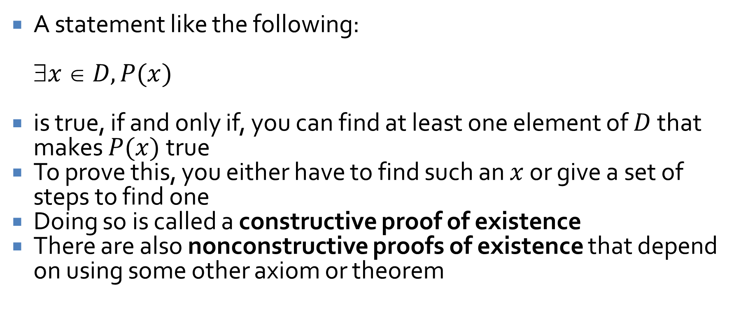
Proving existential statements
A statement like the following:
$x  D, P(x)$
is true, if and only if, you can find at least one element of $D$ that makes $P(x)$ true
To prove this, you either have to find such an $x$ or give a set of steps to find one
Doing so is called a constructive proof of existence
There are also nonconstructive proofs of existence that depend on using some other axiom or theorem

Slide 26
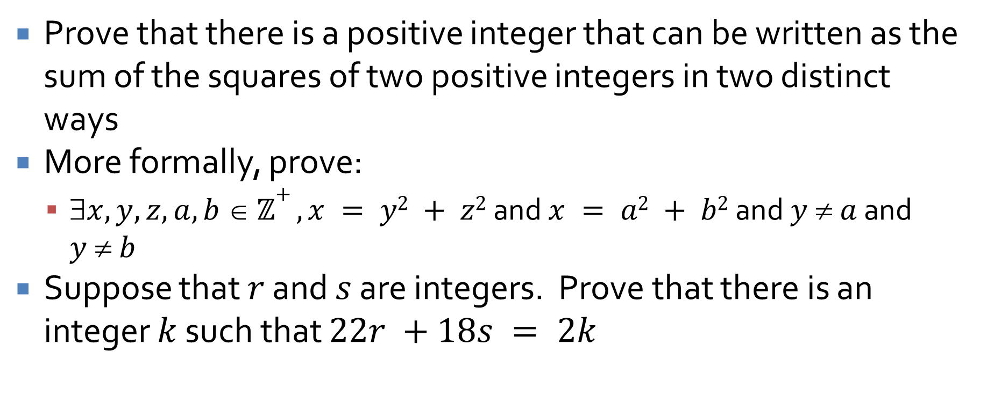
Examples
Prove that there is a positive integer that can be written as the sum of the squares of two positive integers in two distinct ways
More formally, prove:
  $x, y, z, a, b  ℤ+ , x = y2 + z2$ and $x = a2 + b2$ and $y  a$ and $y  b$
Suppose that $r$ and $s$ are integers. Prove that there is an integer $k$ such that $22r +18s = 2k$

Slide 27
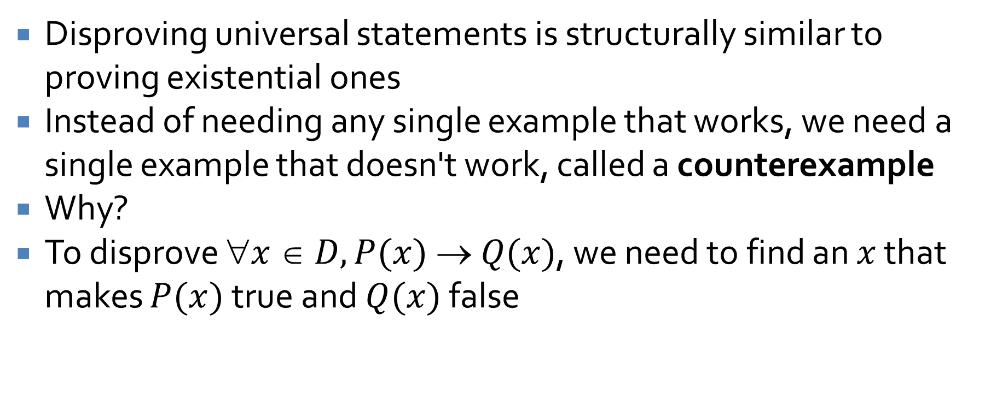
Disproving universal statements
Disproving universal statements is structurally similar to proving existential ones
Instead of needing any single example that works, we need a single example that doesn't work, called a counterexample
Why?
To disprove $x  D, P(x)  Q(x)$, we need to find an $x$ that makes $P(x)$true and $Q(x)$ false

Slide 28

Examples
Using counterexamples, disprove the following statements:
$a, b  ℝ$, if $a2 = b2$then $a = b$
$x  ℤ^{+}$, if $x ≥ 2$ and $x$ is odd, $x$ is prime
$y ℤ^{+}$, if $y$ is odd, then $(y – 1)/2$ is prime

Slide 29
Proving Universal Statements

Slide 30
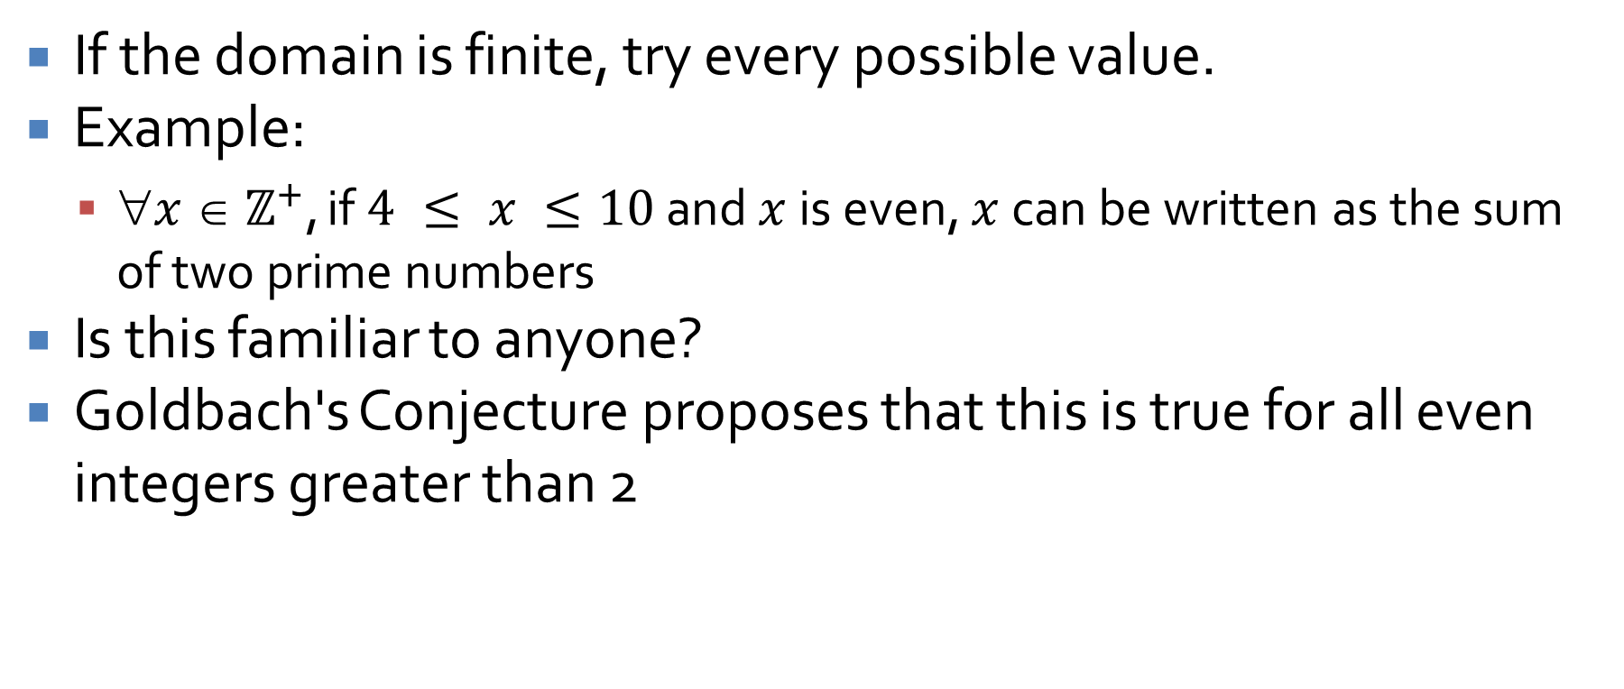
Method of exhaustion
If the domain is finite, try every possible value.
Example:
  $x  ℤ^{+}$, if $4 ≤ x ≤10$ and $x$ is even, $x$ can be written as the sum of two prime numbers
Is this familiar to anyone?
Goldbach's Conjecture proposes that this is true for all even integers greater than 2

Slide 31
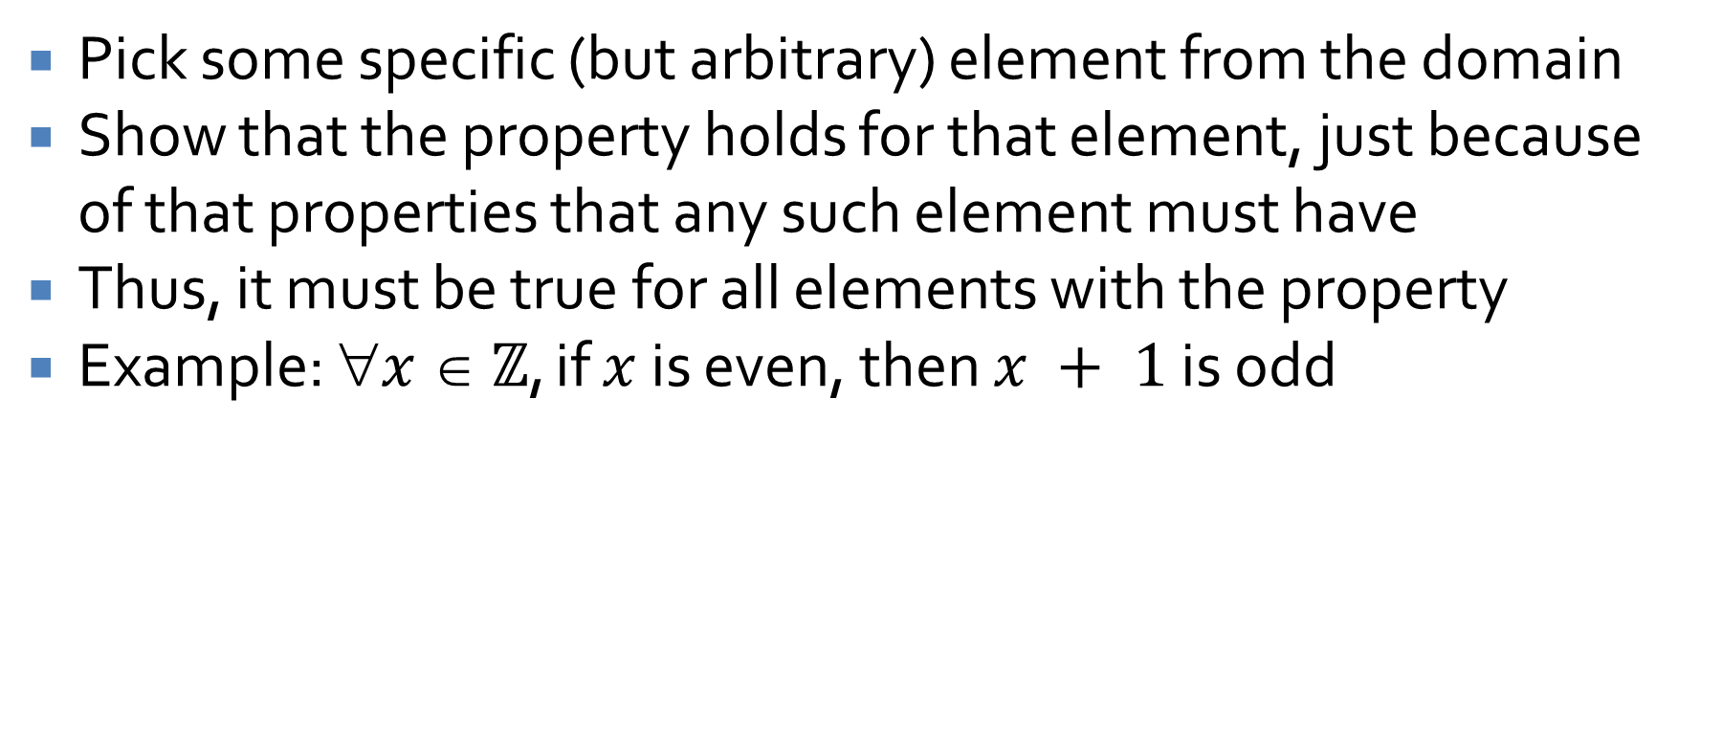
Generalizing from the generic particular
Pick some specific (but arbitrary) element from the domain
Show that the property holds for that element, just because of that properties that any such element must have
Thus, it must be true for all elements with the property
Example: $x  ℤ$, if $x$ is even, then $x + 1$ is odd

Slide 32
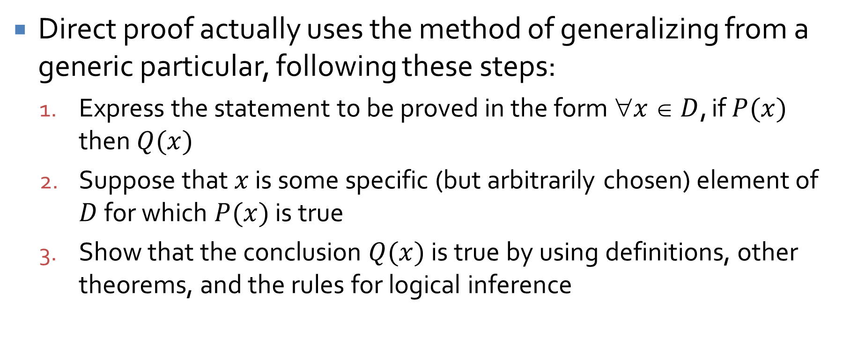
Direct proof
Direct proof actually uses the method of generalizing from a generic particular, following these steps:
  Express the statement to be proved in the form $x  D$, if $P(x)$ then $Q(x)$
  Suppose that $x$ is some specific (but arbitrarily chosen) element of $D$ for which $P(x)$ is true
  Show that the conclusion $Q(x)$ is true by using definitions, other theorems, and the rules for logical inference

Slide 33
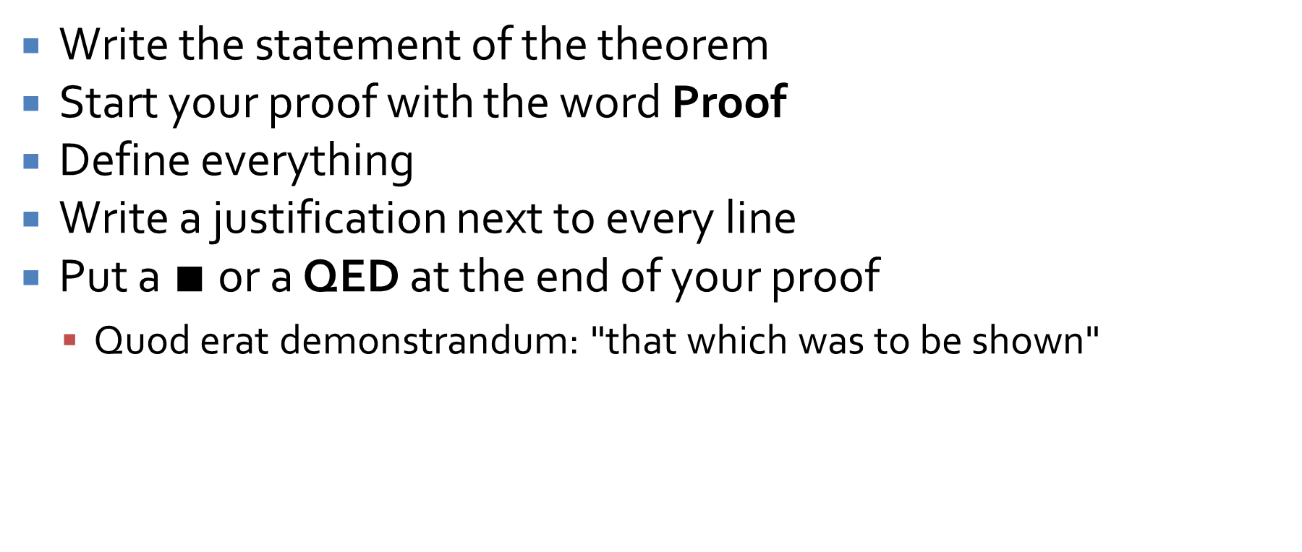
Proof formatting
Write the statement of the theorem
Start your proof with the word Proof
Define everything
Write a justification next to every line
Put a $∎$ or a QED at the end of your proof
  Quod erat demonstrandum: "that which was to be shown"

Slide 34
Direct proof example
Prove the sum of any two odd integers is even.

Slide 35
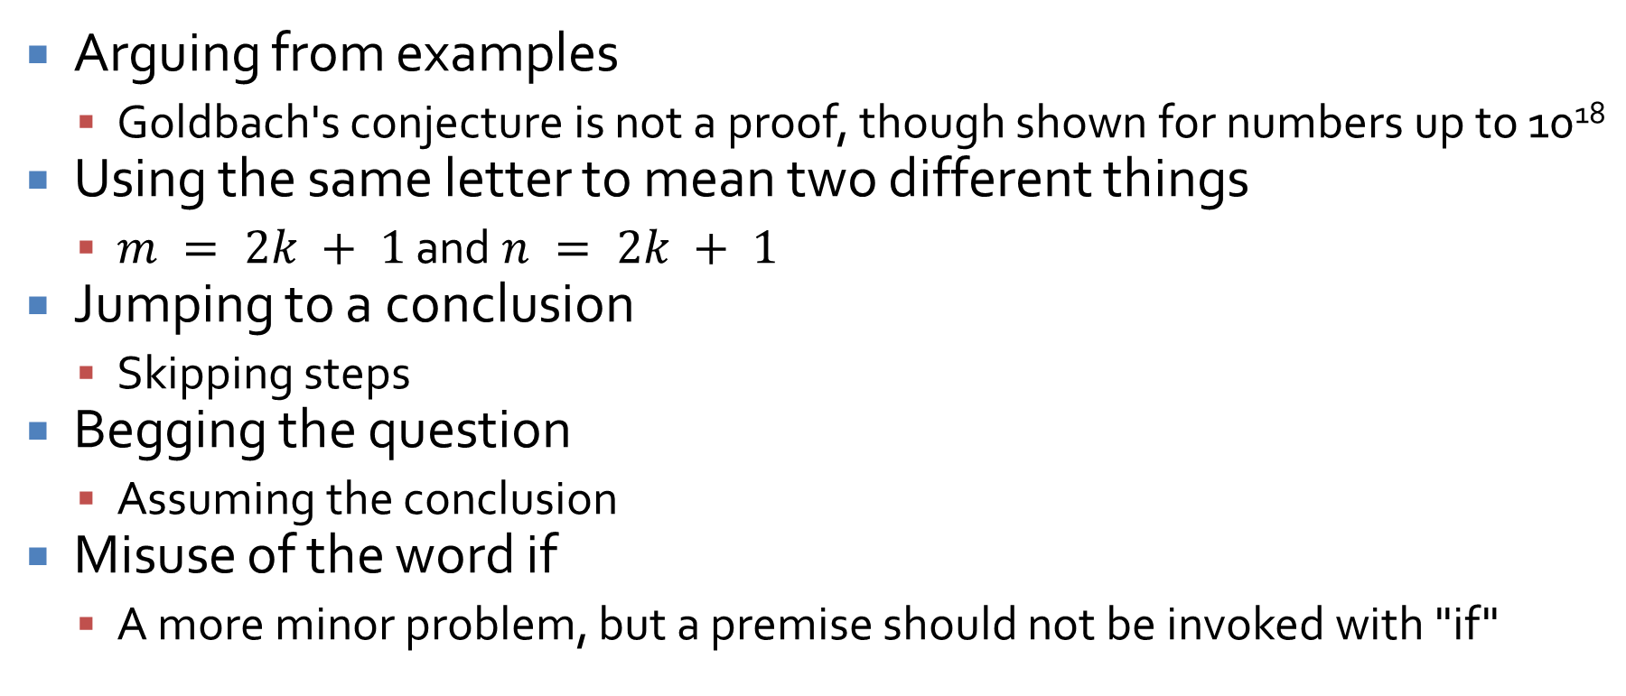
Common mistakes
Arguing from examples
  Goldbach's conjecture is not a proof, though shown for numbers up to 10¹⁸
Using the same letter to mean two different things
  $m = 2k + 1$ and $n = 2k + 1$
Jumping to a conclusion
  Skipping steps
Begging the question
  Assuming the conclusion
Misuse of the word if
  A more minor problem, but a premise should not be invoked with "if"

Slide 36
Disproving an existential statement
Flipmode is the squad
You negate the statement and then prove the resulting universal statement

Slide 37
Upcoming

Slide 38
Next time…
No class Monday!
More proofs
  Rational numbers
  Divisibility
  Proof by cases

Slide 39
Reminders
Read Sections 4.3, 4.4, 4.5, and 4.6
Keep working on Assignment 1

